Slide 1
Alpha Demo: Hikari no To
Computer Games Laboratory 2017/2018
Team Pick One:
Muhammad Inshal Uddin
Paul Preißner
Jonas Mayer
Artem Bishev
Technical University of Munich
10.01.2018

Slide 2
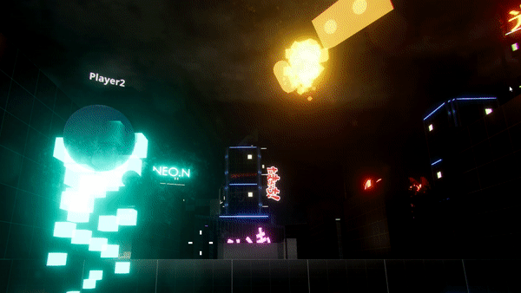
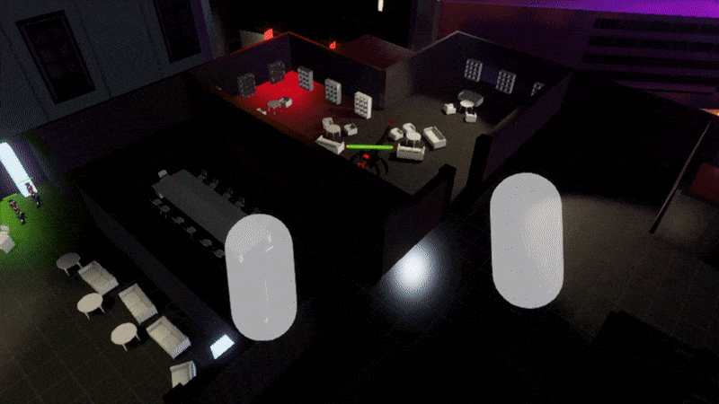
Dungeon Master
RGB
Ping Arrow Hands
Throwables
Next steps:
Polishing
FoW
Simple Teleporting

Slide 3
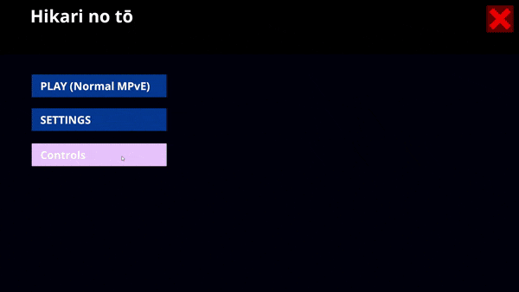
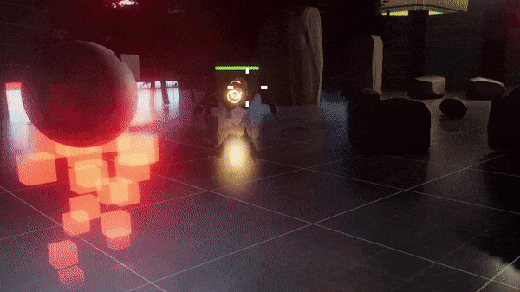
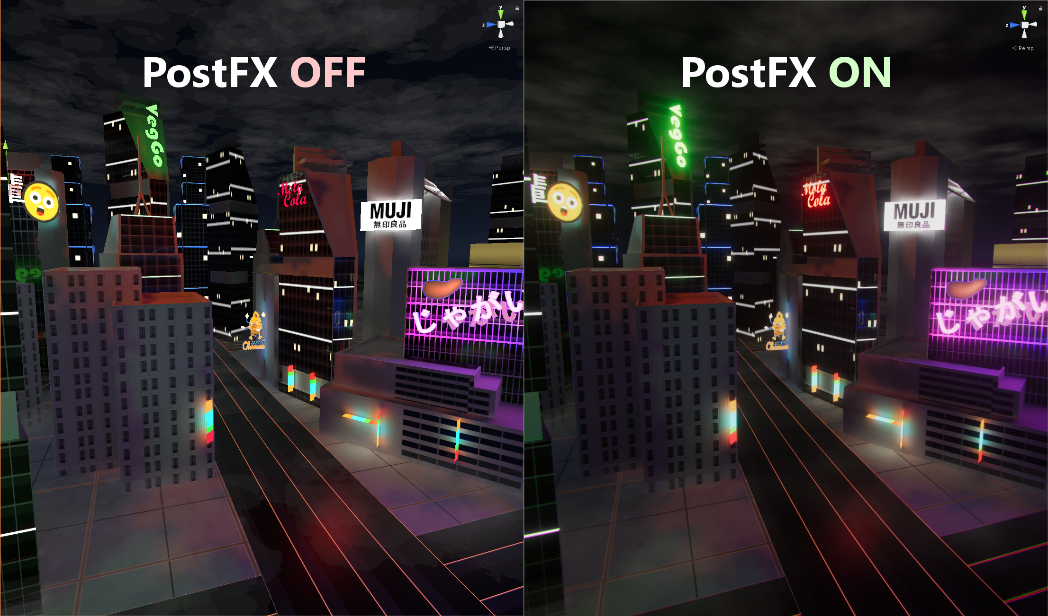
Visuals & UI
Main menu, UI
FX & post FX
Backdrop scene
Props/Rooms
Hit feedback
Next steps:
TBD

Slide 4
Enemies
Four enemy types with two unique models
Includes one boss

Slide 5
Player Classes

Slide 6
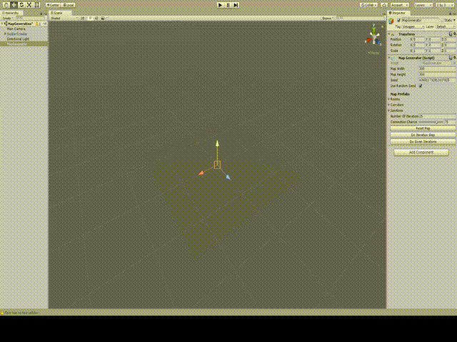
Random Map Generator
“Map Object” Prefabs
Exit Markers
Bounding Box
Allow Connections
Algorithm
Get all exits
Attach a new map object
Connection chance
Overlap checks
Map boundary checks
Rinse and Repeat

